Slide 1







OPTIMIZING RECRUITMENT STRATEGIES FOR TECH STARTUPS
Leveraging Data Insights for Effective Hiring
By Sneha Patil

Slide 2








PROJECT SCOPE AND METHODOLOGY
Analyzing Recruitment Sources and Strategies
Objective
Methodology
Approach
Identify the Best Recruitment Source
Data analysis of candidate sources and recruitment strategies
Utilized exploratory data analysis (EDA) techniques
Data Sources
Tools
Outcome
Internal recruitment data and historical performance metrics
Python,
Data Visualization Libraries
Insights to optimize recruitment efforts and improve hiring outcomes

Slide 3
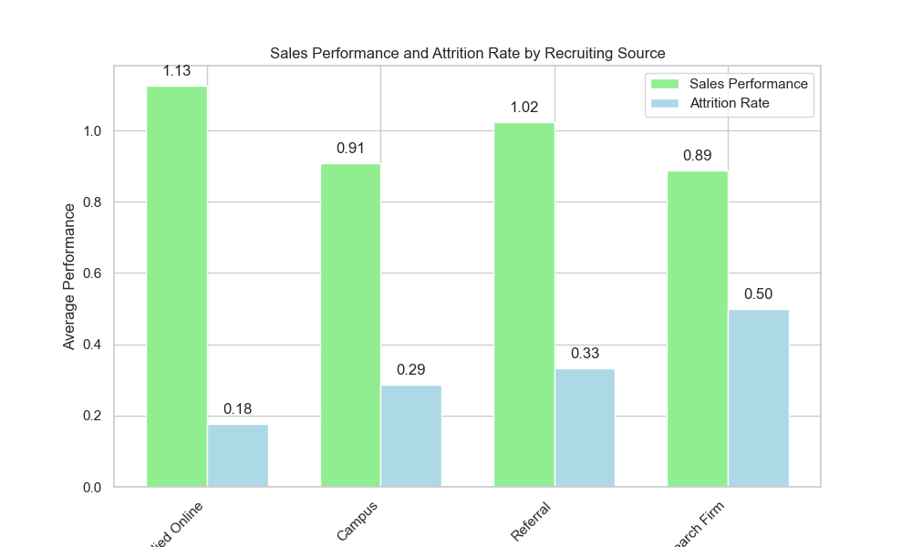
EVALUATION OF RECRUITMENT SOURCES
Understanding Sales Performance and Attrition Rates

Slide 4
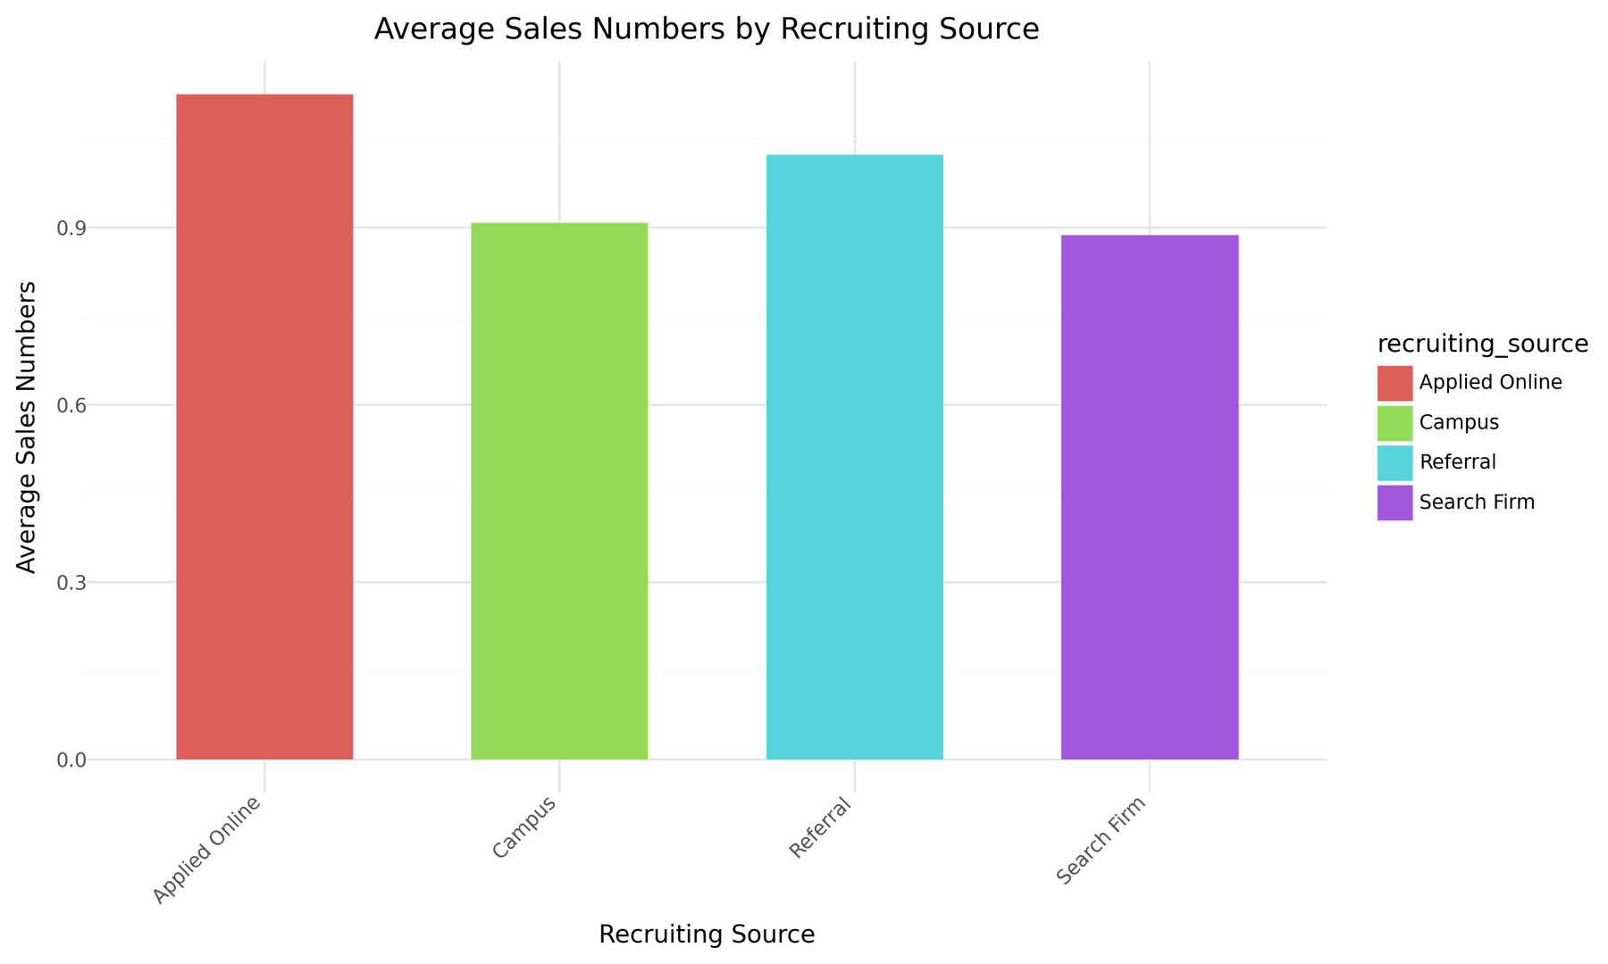
SALES PERFORMANCE BY RECRUITMENT SOURCE
Key Findings and Insights
INSIGHTS:
APPLIED ONLINE: HIGHEST SALES NUMBERS (1.13)
CAMPUS: SLIGHTLY LOWER SALES PERFORMANCE (0.91)
REFERRAL: GOOD SALES PERFORMANCE (1.02)
SEARCH FIRM: LOWEST SALES PERFORMANCE (0.89)

Slide 5
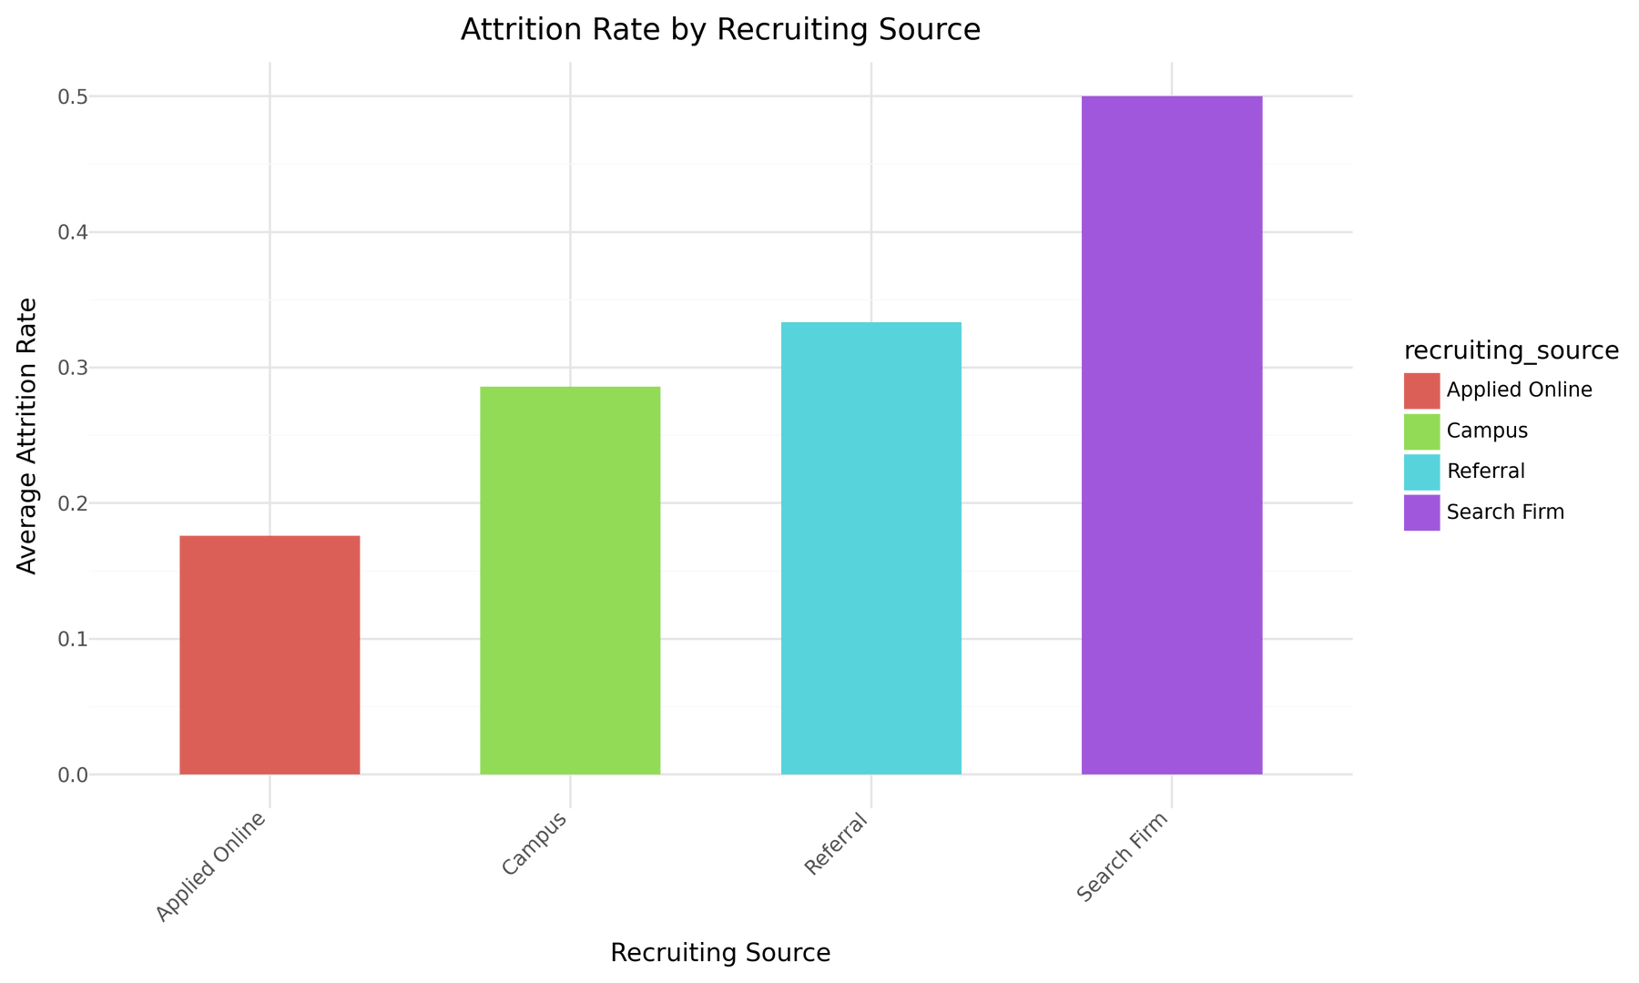
ATTRITION RATES BY RECRUITMENT SOURCE
Understanding Employee Retention
RECRUITING_SOURCE ATTRITION
0 APPLIED ONLINE 0.176119
1 CAMPUS 0.285714
2 REFERRAL 0.333333
3 SEARCH FIRM 0.500000

Slide 6







STRATEGIC RECOMMENDATIONS
Enhancing Recruitment Effectiveness
01
02
03
INVEST IN
SUPPORT
REVIEW
ONLINE RECRUITMENT
CAMPUS AND REFERRAL HIRES
SEARCH FIRM STRATEGIES

Slide 7




FINAL CONCLUSIONS
Identifying the Optimal Recruitment Source
Applied Online: Optimal source with low attrition and high sales
01
Strategic Takeaways: Enhance online recruitment, improve other sources
02

Slide 8

NEXT STEPS AND ACTION PLAN
Implementing Recommendations for Success
01
02
03
Implementation Plan: Outline steps for implementing recommendations
Monitoring and Evaluation: Establish metrics for tracking success
Future Research: Identify areas for further analysis and improvement

Slide 9




THANK YOU!

